Slide 1

Claims MIS/Inflation
Architecture View
Munich, Nov 2022

Slide 2
Claims MIS
Architecture View
Munich, Nov 2022

Slide 3
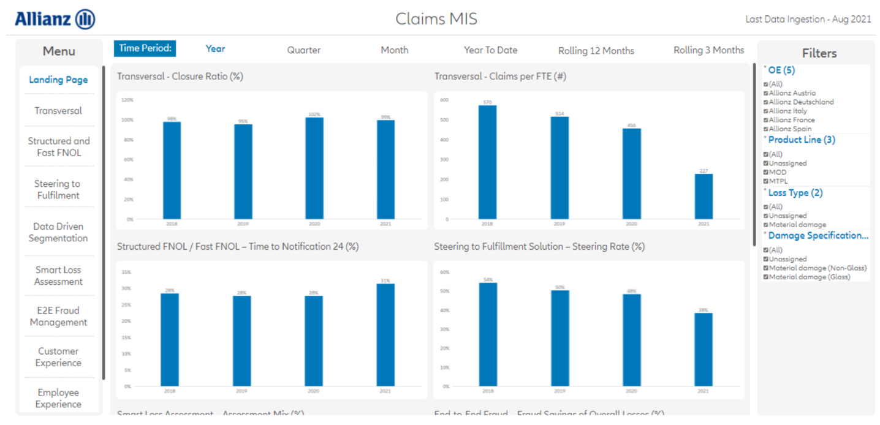


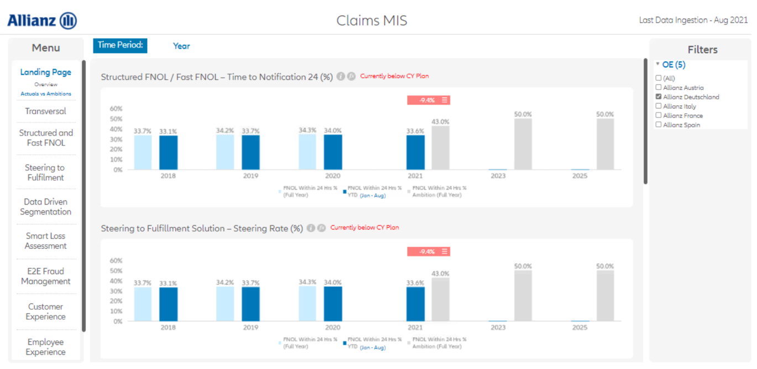

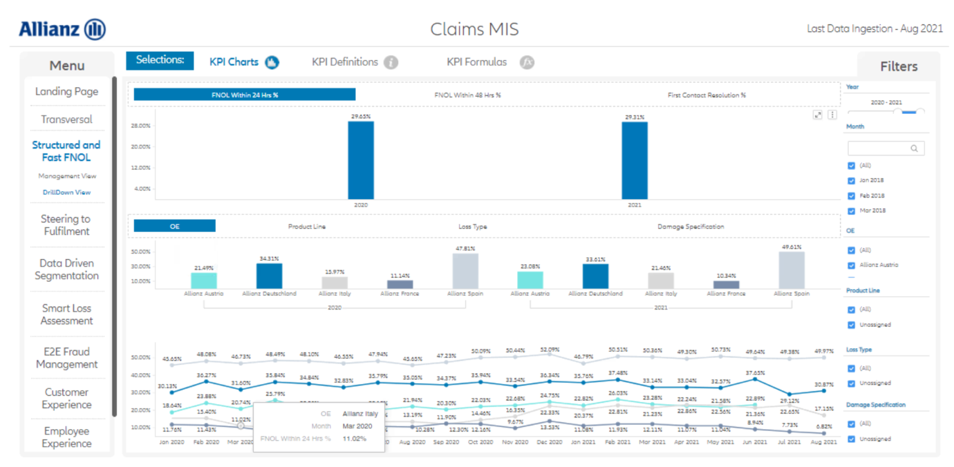
WHY : GOAL & VISION OF CLAIMS MIS in a nutshell
1
Claims MIS: An Overview
Claims MIS serves as a comprehensive reporting suite for Claims (senior) management to facilitate effective business steering and enable performance comparisons across OEs.
Vision / Key principles:
Globally harmonized KPIs
BMP + Legacy data included
Reporting Objectives:
Track impact of ACM Claims initiatives and calibrate ambitions
Compare trends and performance of OEs based on harmonized KPI perspective following the logic of Acc. ACM Claims
Allow analysis of drivers behind KPI development through drill-downs
Automated data transfers from all relevant source systems
Technology:
Visualization Tool: Microstrategy
Cloud: Azure
Data Platform: GDP
Data Source: Legacy
Technical Features: Automated pipelines
+
+
+

Slide 4
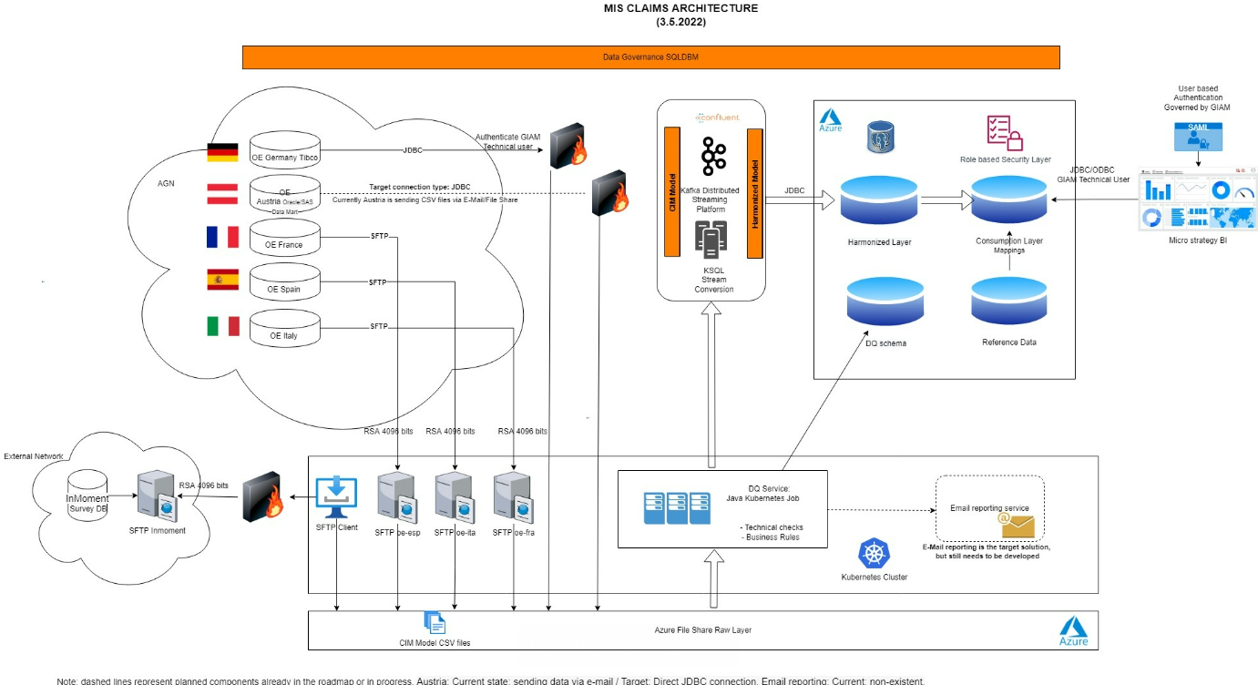
Claims MIS: ARCHITECTURE VIEW
1
Claims MIS: Architecture View

Slide 5
Claims Severity
Architecture View
Munich, Nov 2022

Slide 6



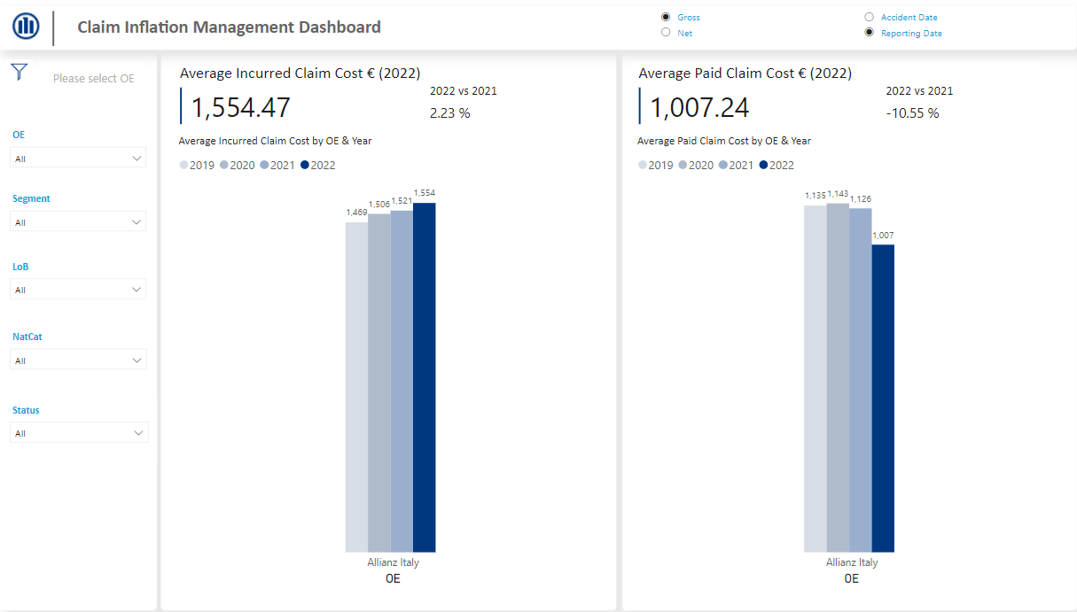


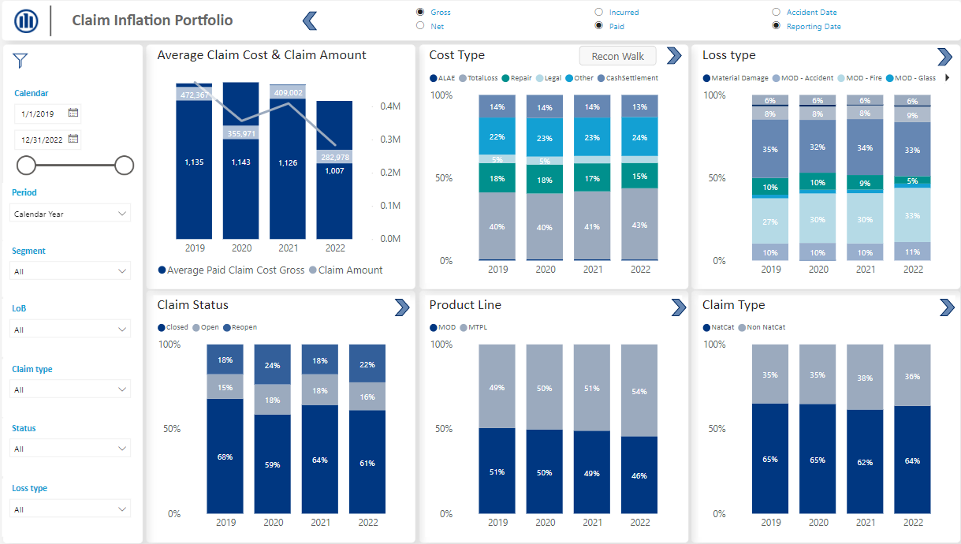




WHAT’S IN THE BOX: Claims Inflation Dashboard at a Glance
Enabled Use Case
Scope & Status
Technology
Purpose: Interactive Dashboard for Group and OE User to understand the impact of inflation on claim costs
Main KPIs:
Overall claim cost
Overall amount of claims
Average claim cost
Status: Pilot is ready for go-live; production ready for further roll-out
Pilot OE:
Data Scope (Pilot): Retail Motor;
2019 - August 2022
Go-Live (Pilot): Q4 2022
Further roll-out: As of Q4 2022
Visualization Tool: PowerBI¹
Cloud: Azure
Data Platform: GDP
Data Source: Legacy
Technical Features: Automated pipelines
Key Functionalities & Features
Functional Views:
Group User View
OE User Portfolio View
Detailed Analysis Views
Flexible Time Views:
Year
Quarter
Month
Toggles:
Incurred/Paid
Net/Gross
Accident/Reporting Year
Dynamic Filters:
OE
Segment
LoB
Loss type
Cost type
…
Interactive Navigation:
Drill through
Navigate between the views
Back button
¹ way forward of best fitting setup to be clarified with AZ Tech

Slide 7
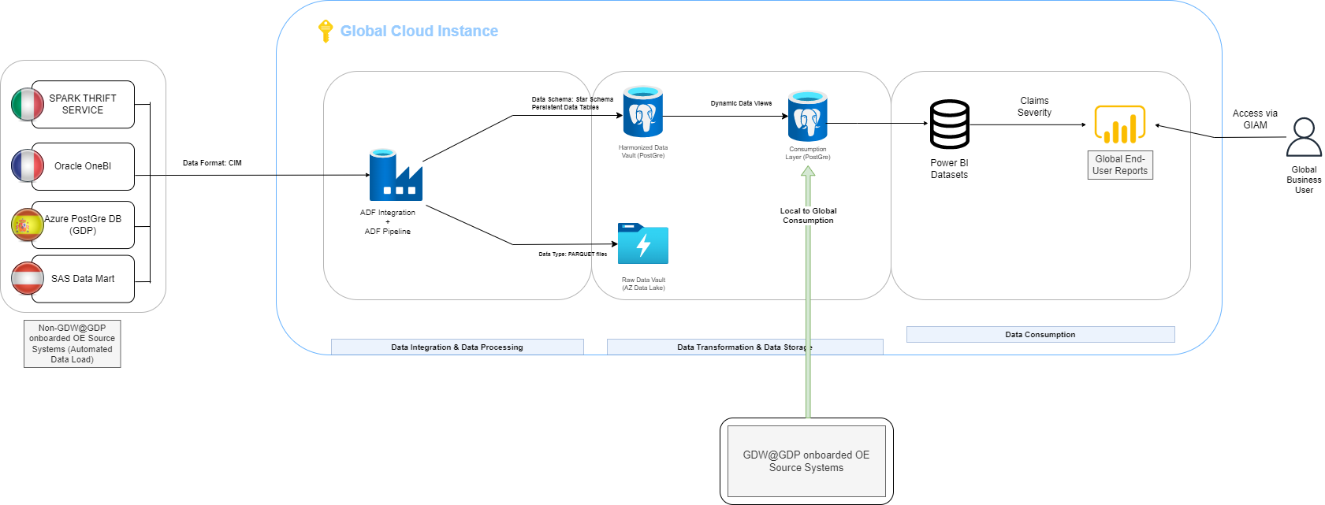
Claims SeveritY: ARCHITECTURE VIEW
1
Claims Severity: Architecture View

Slide 8
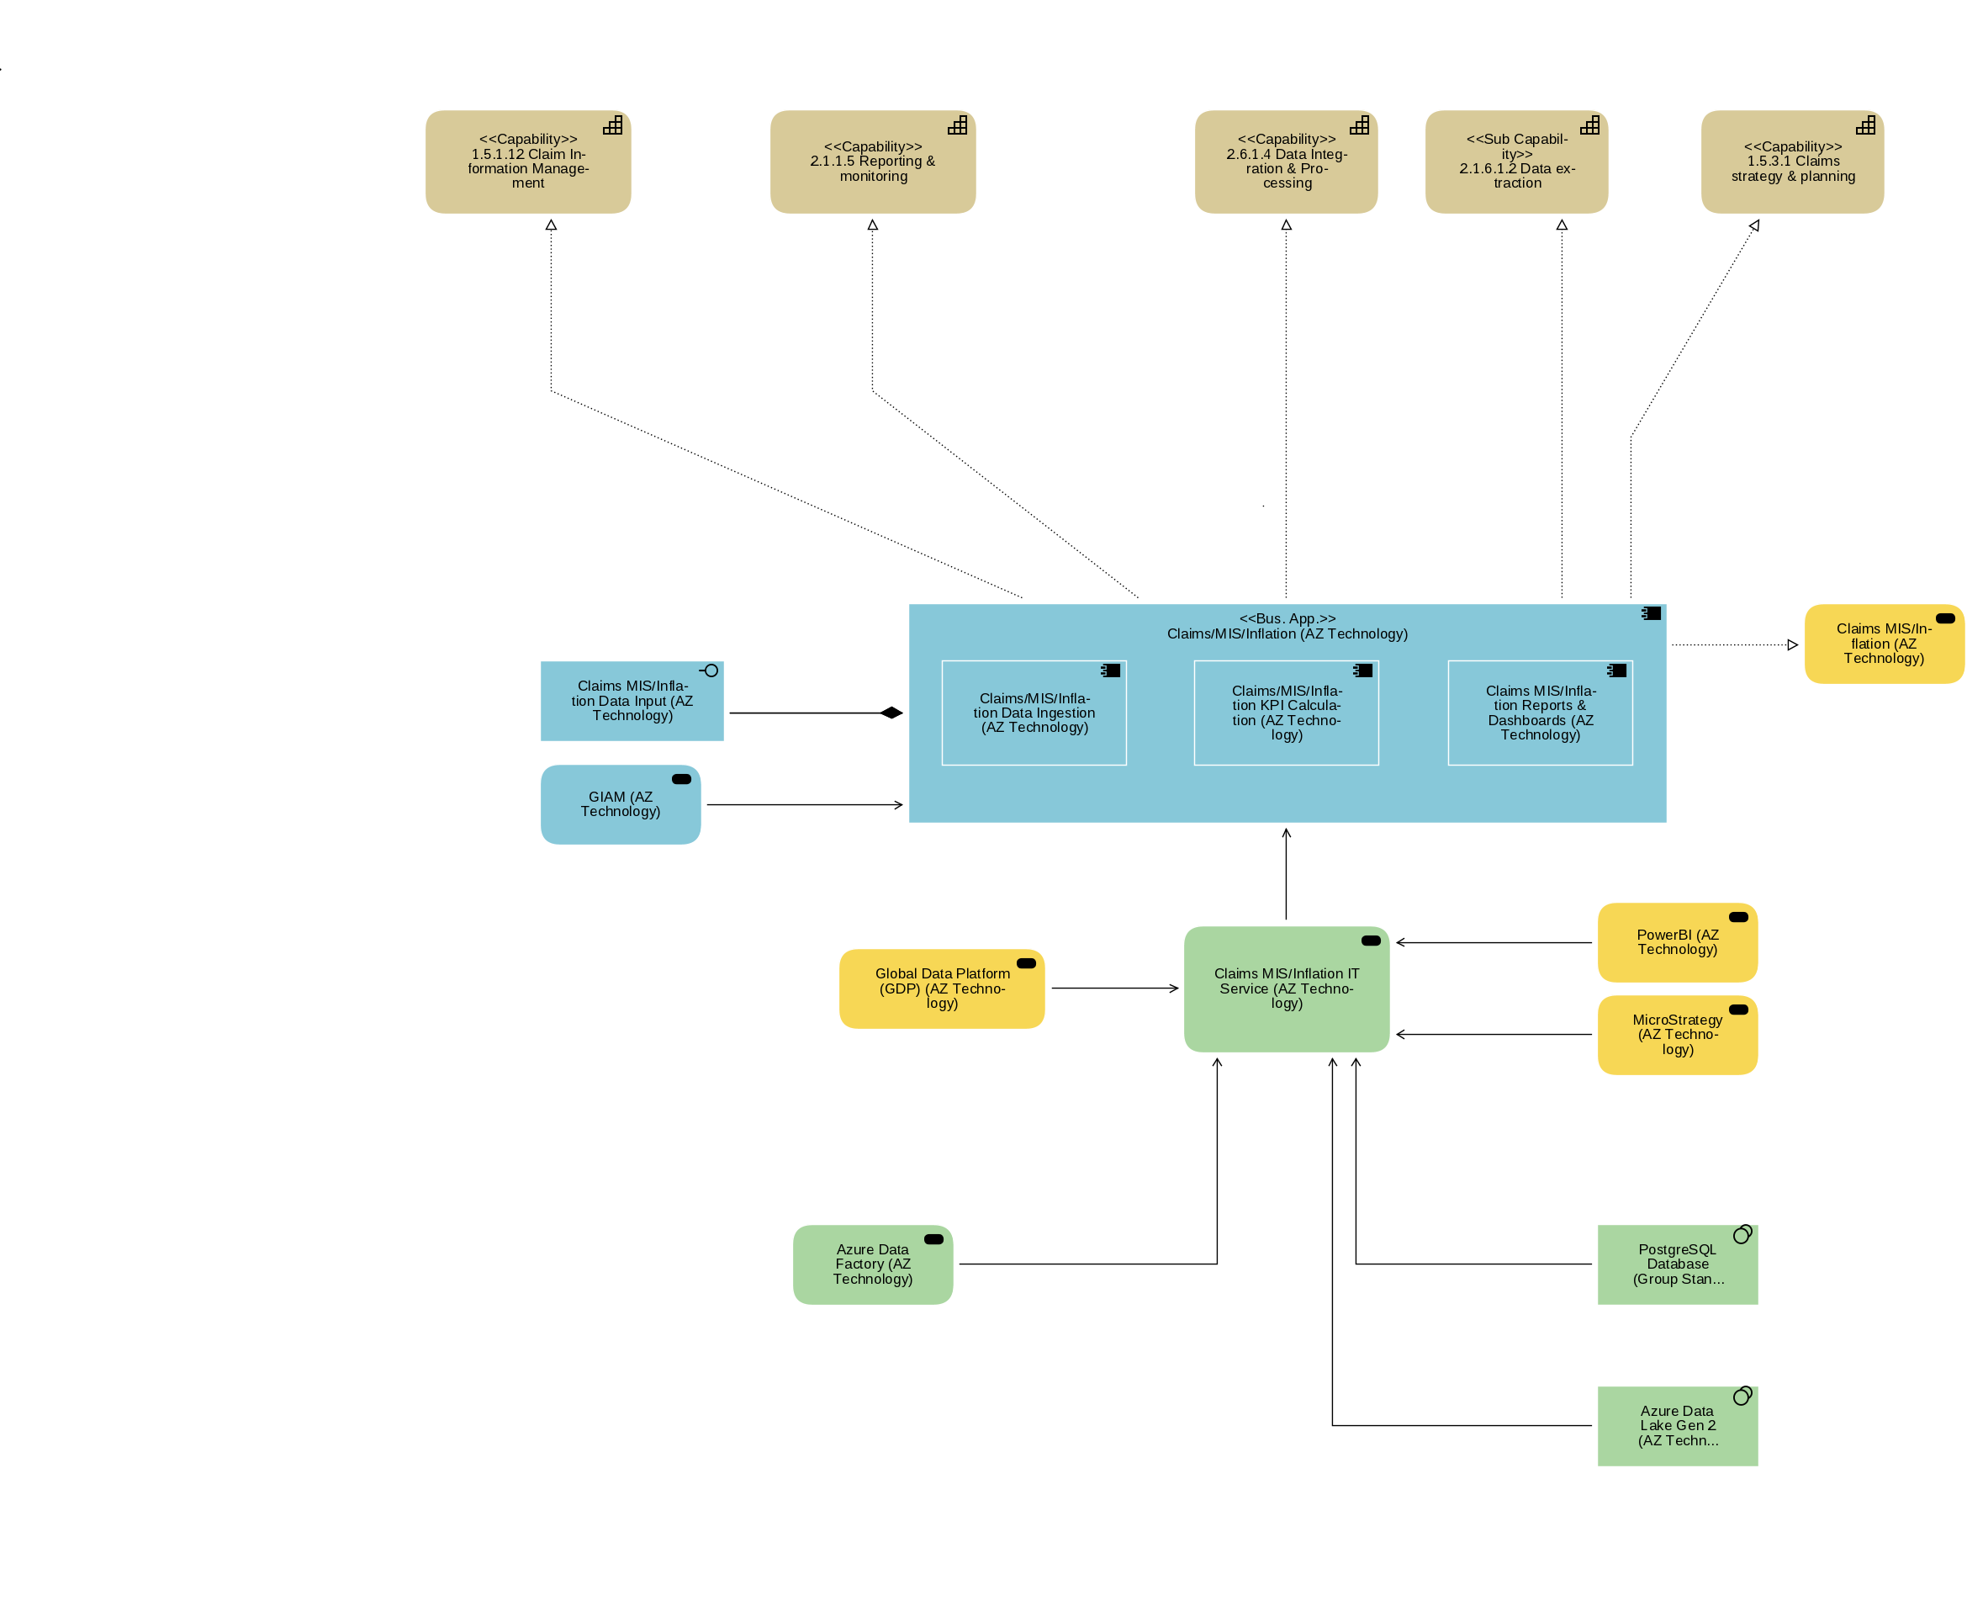
Claims SeveritY: ADOIT MODEl
1
Claims Severity: Architecture View

Slide 9
CLAIMS: Confluence Link
02_Claims Severity/Inflation - Global Data Warehouse (GDW) - JMP Confluence (allianz.net)

Slide 10
CIM Format
OE Ingestion Model
Munich, Nov 2022

Slide 11
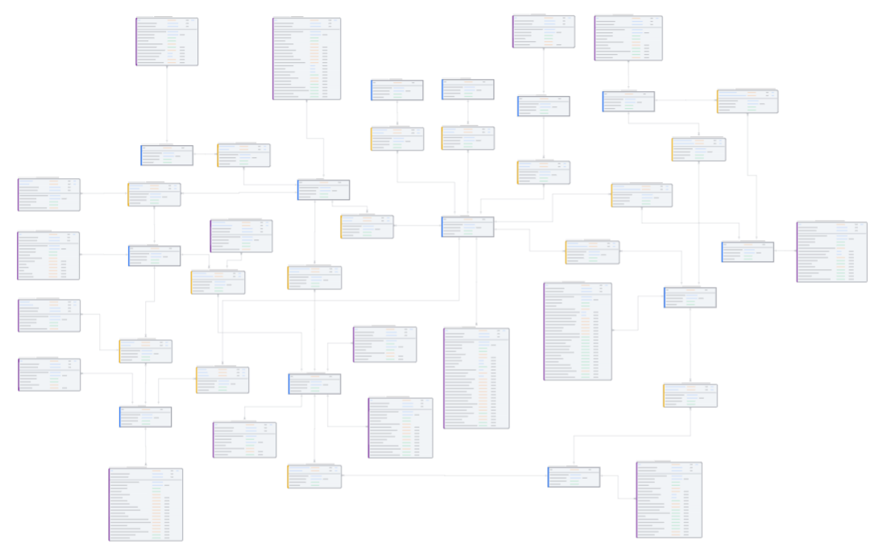
Data Vault Methodology
Advantages of Data Vault (DV)
Adapts to a changing environment easily
Supports very large data sets
Increases usability by business users because it is modeled after the business domain
Allows new data sources to be added without impacting the existing design → no need for reengineering
Supports auditability of data
Supports parallel loading of tables without any dependencies → increases loading performance
HUBs
Links
Satellites
Represent set of business keys that are uniquely identified, with a very low tendency to change.
E.g. hub_policy includes an inventory list for all existing policies.
Represent relationships (transactions, hierarchies or associations) between hubs.
A single link is created for each type of relationship, e.g., a single link record indicates that there is a relationship between a claim and policy
A link contains 2 (or more) business keys
Represent descriptive attributes and contain data that tends to change over time.
A single satellite record is created for each instance of an entity, e.g., for each policy-identifier you can find information about inception date, expiry date and policy status in the satellite policy
A satellite must be attached to a hub or to a link

Slide 12
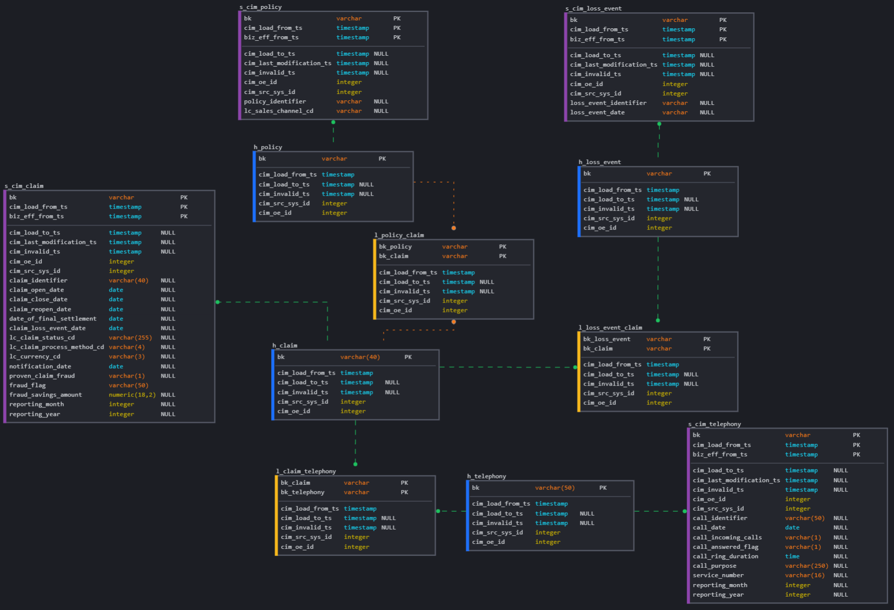
Common Ingestion Model (CIM)
Goals & Principles
CIM is an interface definition for global projects. Main goal of the CIM is to create a global view over all business entities available within the Ontology and the Global Business Glossary.
It also defines the relationships between those entities and establishes one single, harmonized point of truth.
CIM follows Data Vault principles and is therefore:
flexible to changes
scalable
auditability.
Existing entities in the CIM can be reused by any new project and new OE onboarding.
Currently the following global projects are using the CIM:
ACM Claims
Commercial P&C
Alex for ADH

